Slide 2
Maxymiser Campaign Acceptance Document
Test 48 – AA – v1.0
Athanasios Dimisioris
Analyst
15. August 2016

Slide 3
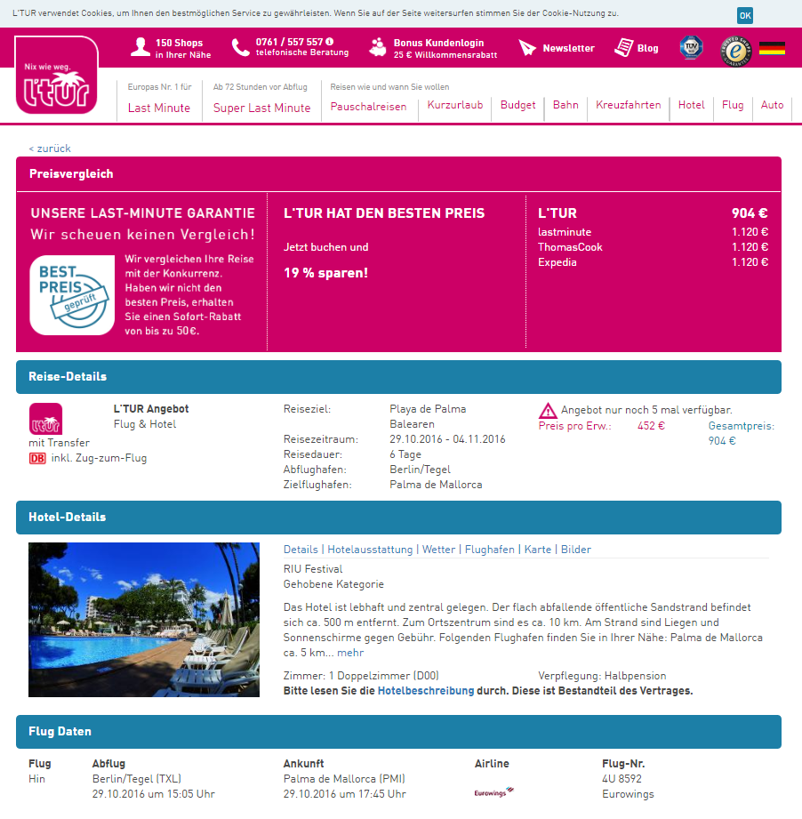
Campaign Background and Objectives
Campaign Background
LTUR wants to check the general conversion tracking of Maxymiser tool.
Campaign Objective
It´s an AA-test, so there´s no objective beside checking the results.
As LTUR
I want to check the conversion tracking
So that I can be sure that tracking is correct.
Campaign Hypotheses
In AA-test the results will interchangeable and there won´t be any significance.
Notes:
To Replace the Picture on this Sample Slide (this applies to all slides in this template that contain replaceable pictures)
Click the icon inside the shape to open the Insert Picture dialog box. Navigate to the location where the picture is stored, select desired picture and click on the Insert button to fit the image proportionally within the shape.

Slide 4
General Campaign Setup
AA-test

Slide 5
Browser Rules
This campaign will be deployed to the following devices:
☑ Desktop
☒ Tablet
☒ Mobile
The following is a customized list of browsers to be INCLUDED in the campaign:
DESKTOP DEPLOYMENT
INCLUDED
Browser |  | Operating System
Type | Version | Type
Chrome | Any | Any
Edge | Any | Any
IE | 11 | Any
Firefox | 30+ | Any
Safari | 9 | Any

Slide 6
Generation Rules
User Story: Name
As LTUR
I want to check the conversion tracking
So that I can be sure that tracking is correct.
Acceptance Criteria | Given | When | Then
1. Acceptance Criteria | User has chosen for a hotel on result page | They are on the Hoteldetails page | The test is generated.
Notes:
This is a sample Table slide, ideal for comparing data by year, product, revenues, etc. To Edit this Table, follow the steps below (this applies to all slides in this template that contain tables):
To Change Text in Table: Select text in table. Begin typing desired text. To move from one cell to another, press Tab.
To Change Font Color/Size: Select text, right-click and adjust the font setting on the Mini toolbar. Select desired attributes to change: font, size, boldness, color, etc. Note: many of the same commands can also be accessed from the Font group of the Home tab.
To Insert or Delete Rows in Table: To delete a row place cursor in a cell of the row, right-click for a pop up menu, select Delete Row. To Insert a row, place cursor in the row you want to place a row before, right-click for a pop up menu, select Insert and make a selection from the submenu. You can also use the Insert and Delete Rows and Columns tools on the Table Tools Layout tab to perform these actions.
To Insert or Delete Columns in Table: To delete a column, place cursor above the column (you will see a solid downward pointing arrow) click to select the column, right-click on the selected column, chose Delete Column from the pop up menu. To insert a column, place cursor above the column you wish to insert the new column before (you will see a solid downward pointing arrow) click to select the column, right-click for a pop up menu, select Insert and make a selection from the submenu. You can also use the Insert and Delete Rows and Columns tools on the Table Tools Layout tab to perform these actions.
To Highlight a Cell, Column or Row (for emphasis): Click to select an individual cell or click and drag through the desired column(s) or row(s). From the Table Tools Design tab, select the Shading button and select a desired fill color. (Note: It is best to use white text over dark backgrounds and black or dark gray text over light backgrounds.) While a table is selected, other formatting options are available on the Table Tools Design and Layout tabs.

Slide 7
Campaign Matrix
Element | Variant 1 | Variant 2
A - Insurance | Default | AA
Notes:
This will be an AA test with 2 experiences
-> The goal is to find out if Maxymiser tracking is correct.
Notes:
To Replace the Picture on this Sample Slide (this applies to all slides in this template that contain replaceable pictures)
Click the icon inside the shape to open the Insert Picture dialog box. Navigate to the location where the picture is stored, select desired picture and click on the Insert button to fit the image proportionally within the shape.

Slide 8
Campaign Variant – A1 Default
User Story:
As LTUR
I want to check the conversion tracking
So that I can be sure that tracking is correct.
Acceptance Criteria | Given | When | Then
1. Acceptance Criteria | User is generated in the test | The hotel detailpage is reached | The user will see the default experience

Slide 9
Campaign Variant – A2 - AA
User Story:
As LTUR
I want to check the conversion tracking
So that I can be sure that tracking is correct.
Acceptance Criteria | Given | When | Then
1. Acceptance Criteria | User is generated into A2 | The hotel detailpage is reached | The user will see the same page like in Default

Slide 10
Metrics
Actions

Slide 11
Metric Overview
The Metrics shown below shall be tracked in this campaign in order to measure success.
Metric | Description | Value | Attributes
1. Metric Booking | The amount of users progressing to the confirmation page should be tracked | Revenue | Ins
2. Metric BD1 | When the user lands on the BD1 step | - | Ins
3. Metric BD2 | When the user lands on the BD2 step | - | Ins

Slide 12
Booking
User Story:
As LTUR
I want to track how many users are continuing to the confirmation page
So that I can analyse the users behavior in the variants.
Acceptance Criteria | Given | When | Then
1. Acceptance Criteria | The user is generated into the test | The user continues to the confirmation page | The metric should track
2. Acceptance Criteria | The user continues to the confirmation page | The metric is tracked | The revenue should be tracked as a value.
3. Acceptance Criteria | The user continues to the confirmation page | The user has chosen an insurance | The value “Ins” should be tracked

Slide 13
BD1
User Story:
As LTUR
I want to track how many users are continuing to the next page
So that I can analyse the users behavior in the variants.
Acceptance Criteria | Given | When | Then
1. Acceptance Criteria | The user is generated into the test | The user continues to the BD1 page | The metric should track
2. Acceptance Criteria | The user continues to the BD1 page | The user has chosen an insurance | The value “Ins” should be tracked

Slide 14
BD2
User Story:
As LTUR
I want to track how many users are continuing to the BD2 page
So that I can analyse the users behavior in the variants.
Acceptance Criteria | Given | When | Then
1. Acceptance Criteria | The user is generated into the test | The user continues to the BD2 page | The metric should track
2. Acceptance Criteria | The user continues to the BD2 page | The user has chosen an insurance | The value “Ins” should be tracked

Slide 15
Additional Information

Slide 16
Integration Details
User Story:
As L’TUR
I want to integrate Omniture
So that I can track the test result in my own analysis tool.

Slide 17
Athanasios Dimisioris
Analyst
Athanasios.Dimisioris@oracle.com
15. August 2016

